Slide 1

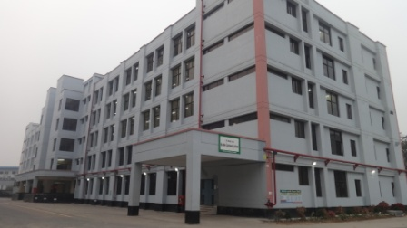
Baridhi Garments Ltd.
sfb # 7, Comilla EPZ, Comilla. Bangladesh.
Compliance Status
June- 2018.

Slide 2


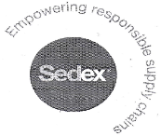
Certification Status
SL No | Name of Certification | Audit Company | Audit Status | Last Audit Date | Next due Date | Remarks
1 | BSCI | SGS | C | 13/14/2018 | 13/14/2019
2 | SEDEX | PEERLESS | Pass | 30/12/2017 | 30/12/2018
3 | INDITEX | SGS | Waiting For Result. | 05/08/2017 | 05/08/2018
4 | SEDEX | INTERTEK | Pass | 20/12/2016 | 20/12/2017

Slide 3
Audit status for Brands
SL No | Name of Buyer | Audit Company | Audit Category | Audit Status/Marks/Grading | Target | Last Audit Date | Next due Date | Remarks
1 | H&M | Higg | Social | 47% | 53% | 26-Sept-17 | Sept-18
2 | H&M | Higg | Environment | 38% | 28% | 26-July-18 | 26 July-19
3 | Decathlon | Self | HRP | C | B | 13-May - 2018 | 13-Nov-18

Slide 4

Inspection Name | Audit Category | In Progress | Last Audit Date | Present Status
Fire | ^{3nd} follow up Total issues - 17 Total issues Correct – 15 | All Done. | 14th Sep-2017
Electrical | ^{3ndt} follow up Total issues - 15 Corrected issues – 15 | N/A | 14th Sep- 2017 | 100% Verified.
Structural | 1st follow up Total issues - 05 Correct issues – 01 | DEA Approval Pending. | 05th January 2017

Slide 5

Inspection Name | Audit Category | Present Status | Last Audit Date | Remarks
Fire | 1st follow up Total issues - 32 Total issues Correct – 25 | All Complete. | 03-March-18
Electrical | 1st follow up Total issues - 47 Total issues Correct – 34 | All Complete | 03-March-18
Structural | 1st follow up Total issues - 12 Total issues Correct – 07 | Retrofitting pending | 03-March-18

Slide 6
WORKER SURVEY REPORT
SL NO | AREA | LAST YEAR-16 | PRESENT YEAR -17.
1 | PAYMENT OF WAGES | 100% | 100%
2 | LIVING WAGES | 42% | 58%
3 | MINIMU WAGES | 33.3% | 52.3%
4 | PREVAILLING WAGES | 20% | 1.1%
5 | PAYMENT OF W/H | 83.3% | 96.7%
6 | WAGES DISCRIMINATION | 54.4% | 22%
7 | PAY SYSTEM | 66.7% | 90.1%
8 | COMMUNICATION & SOCIAL | 23.1% | 76.9%
9 | REAL WAGES | 100% | 97%
10 | WAGES SHARE | 80% | 98.9%
11 | WAGES COST
12 | WAGES & HUMAN CAPITAL | 31.3% | 68.1%

Slide 7

Done
Main Issue
# Factory plans to make 1 storey vertical extension above the existing 5 storey factory building. Their building is owned by BEPZA and they have communicated with BEPZA regarding that. So please give us update on it and provide the DEA copy for our understanding.
# Overall BSCI result “c"
# Fire protection system work was not in function due to installation of pump which will be completed by 1 week. Once completed, please provide the supporting evidence.
# Increase the first aid facilities in the production floors.
# First aiders training were not regularly conducted.
# Some of the records found not updated like personal files, sign in different benefits, update maternity registers, etc.
# Separation of ramp area is required.
# Provident fund approved papers and policy.
# Supporting of contribution to BEPZA welfare fund.
# Provide at least 350 lux illumination for label cutting section.
# Survey on current grievance system need to done.
# Increase the awareness on PPE use for all relevant sections.
# Workers personal lockers were found opened. Increase the awareness and ensure all their personal belongings are safe & secure.

Slide 8
The End

